Slide 1




E-Waste Tracking and Management
TG08003219
Author 1
Photo
Author 2
Photo
Author 3
Photo
Author 4
Photo
Deepika T R
Deepthi K
Nishanth K J
Skanda P M
Maharaja Institute of Technology Mysore
Mysore
Dr. Victor Ikechukwu Agughasi

Slide 2
Challenge Statement
Electronic waste (E-waste) is a rapidly growing global issue due to the increasing pace of technological advancements and consumerism[1]. [2].
Improper disposal of e-waste poses significant risks to the environment and public health, as valuable materials are wasted, and hazardous substances are released[3].
Despite existing efforts, only a fraction of e-waste is effectively collected, tracked, and recycled.
The challenge is to develop an innovative, scalable, and transparent e-waste tracking and management solution that ensures efficient collection, segregation, and recycling while addressing critical factors such as data privacy, user engagement, and real-time monitoring[4].

Slide 3

Concept / Solution - 1
Concept:
The E-Waste Tracking and Management System addresses the growing challenge of electronic waste (e-waste) through an innovative, technology-driven approach.
It integrates real-time monitoring, user engagement, and data analytics to manage e-waste effectively from its generation to final disposal[5].
The system promotes transparency, user trust, and sustainability by leveraging advanced technologies and collaboration with certified recycling vendors.

Slide 4
Concept / Solution - 2
Solution:
QR Code Integration: Each device is assigned a unique QR code during manufacturing, containing details like material composition, lifecycle, and disposal guidelines.
Mobile App Interaction: Consumers use the E-Waste Manager App to scan the QR code, locate nearby drop-off points, or schedule pickups with certified recyclers.
Recycling and Tracking: At recycling centres, the QR code is scanned into a blockchain system, ensuring transparent tracking of dismantling and material reuse processes[6].
Reward System: Users earn eco-points for recycling, redeemable for discounts on eco-friendly products, motivating responsible disposal behaviour.
Improvements:
Standardized QR Codes for universal use.
Smart Contracts to automate rewards.
Gamification to encourage participation.
Government Dashboards to monitor recycling rates and policies.

Slide 5
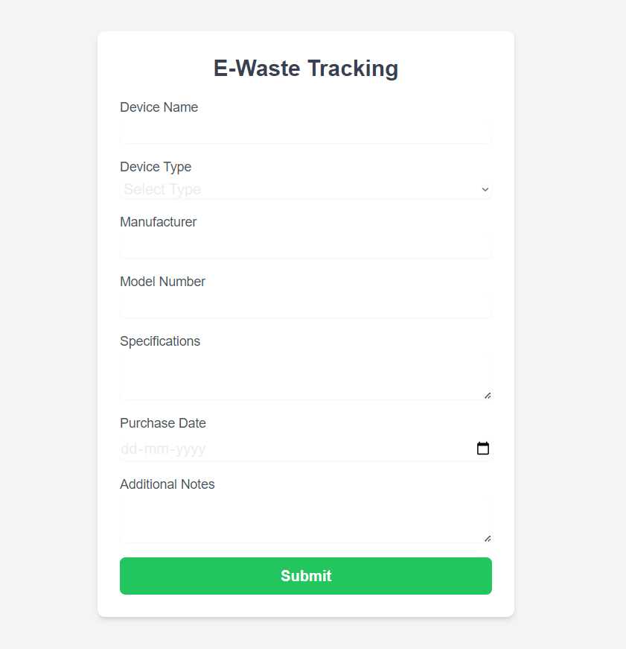
Current Status of POC
Frontend:
In Progress :
Mobile and web interfaces developed for user interaction.
Features include QR code scanning, drop-off point location, and scheduling pickups.
Backend:
In Progress:
Django-based backend with APIs under development.
QR code management, user authentication, and recycling tracking being implemented.
Integration with blockchain for transparent tracking is ongoing.
Blockchain Integration:
Basic blockchain configuration in progress to ensure tamper-proof tracking of e-waste recycling.
Database:
PostgreSQL and MongoDB setup initiated for structured and unstructured data storage.
Implementation Phases:
Phase 1: Planning and design completed with system architecture and tool selection.
Phase 2: Backend and database development underway.
Phase 3: Integration of frontend, backend, and blockchain components planned.
Deployment:
Cloud hosting options like AWS or Heroku identified for deployment.

Slide 6
Further Plans and Testing process
Testing Process
Unit Testing:
Test individual components (QR code APIs, blockchain, reward system).
Integration Testing:
Ensure seamless interaction between frontend, backend, and blockchain.
End-to-End Testing:
Validate the complete workflow from QR code assignment to recycling.
Performance Testing:
Conduct stress tests to evaluate scalability under heavy loads.
Security Testing:
Test data privacy, blockchain security, and overall system vulnerabilities.
User Testing:
Gather feedback from real users to refine ease of use and functionality.
Continuous Monitoring:
Track system performance post-deployment and implement updates as needed.
Further Plans
Backend Completion:
Finalize APIs for QR code management, user authentication, and recycling tracking.
Complete blockchain integration for transparent e-waste tracking.
Advanced Features:
Implement AI-based waste classification for automated segregation.
Integrate a reward system with smart contracts for eco-points.
Deployment:
Deploy backend and blockchain on AWS/Heroku.
Launch the mobile app on the Android Play Store.
User Engagement:
Partner with recycling vendors and run marketing campaigns.
Add gamification features to increase user participation.
Scaling:
Monitor usage and optimize resources for growing user demand.
Expand features based on user feedback and system analytics.

Slide 7
Queries to the mentors
Can we change the tech stack to remove major components like blockchain? What alternative approaches can we use for ensuring transparency and tracking?
What are the best practices for managing the project efficiently and ensuring minimal technical debt during development?
Which is the best tech stack to achieve scalability, cost-effectiveness, and ease of development for this project?
Are we going to receive any financial support for hosting the project on cloud platforms?
How should we structure the project for seamless integration and long-term maintenance?
When is the ideal deadline to complete the project, considering key milestones and deliverables?

